Slide 1
Adopt-A-Stream Training

Slide 2
Water Quality Supplies
Waste bottle
1413 solution
pH 10 solution
pH 4 solution
Solution cups
Water sample cup
Hanna Meter

Slide 3
Proper water quality technique
Turning on meter
pH quality check
1413 quality check
Sampling water
pH post sampling quality check
1413 post quality check
Hanna Meter calmibration

Slide 4
Turning on Hanna Meter
Press and hold the mode button to turn hanna meter on or off.

Slide 5
Hanna Meter
pH setting
Clock
Sample recording
Temperature recoding

Slide 6
pH 4 pre sampling
Once meter is on, press the set/hold button until pH appears in the right corner.
Fill pH4 cup to line with pH4 solution.
Insert Hanna meter into pH 4 solution a clock will appear in the left hand corner.
Take recording after clock stops.
If pH levels are not in the appropriate range conduct recalibration.

Slide 7
1413 pre sampling
Once meter is on, press the set/hold button until US symbol appears in the right corner.
Fill 1413 cup with 1413 solution to line.
Insert probe into solution clock will appear on the left hand side take recording when clock stops.
If 1413 (conductivity) levels are not in the appropriate range conduct recalibration.

Slide 8
Sampling water
Put cup directly into an undisturbed section of the stream and fill with water.
Turn on Hanna meter and place into water.
Use the set/hold button to switch between pH and US (conductivity)

Slide 9
Sampling water continued
In pH mode with probe in water clock will appear on the left hand side.
Wait for clock to turn off and take your first recording.
Keeping probe in water wait 15 seconds and take seconds recording, wait 15 seconds and take third recording.
Follow these same steps to record conductivity.

Slide 10
pH 10 post sampling check
Once meter is on, press the set/hold button until pH appears in the right corner.
Fill pH10 cup to line with pH10 solution.
Insert Hanna meter into pH 10 solution a clock will appear in the left hand corner.
Take recording after clock stops.

Slide 11
Conductivity post sampling check
Once meter is on, press the set/hold button until US appears in the right corner.
Fill 1413 cup to line with 1413 solution.
Insert Hanna meter into 1413 solution a clock will appear in the left hand corner.
Take recording after clock stops.

Slide 12
When to recalibrate?
When pre sampling control readings are not within the proper range recalibrating is needed.
These acceptable ranges are as follows
pH 4 while in pH 4 solution should range between 3.8 and 4.2
1413 while in 1413 solution should range between 1342 and 1482
These ranges are also printed on each sampling field data sheet.

Slide 13
Recalibration for pH
To recalibrate the pH, while the meter is in pH mode,
Press and hold the mode button the meter will say off- continue to hold until the word Cal appears.
It will say use pH7, once calibrated it will prompt you to use pH4.
The meter will then be calibrated and sampling can begin.

Slide 14
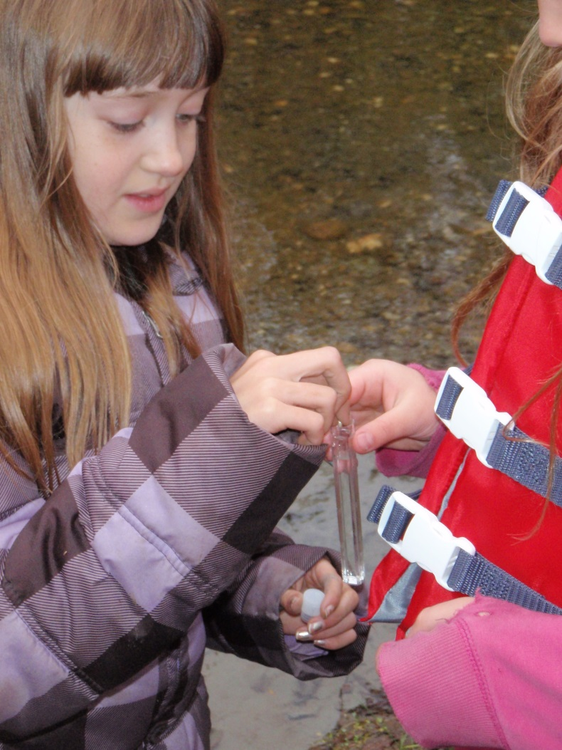
Recalibration for conductivity
To recalibrate conductivity have to meter in US mode.
Press and hold the mode button the screen will say off- continue to hold until it word Cal appears.
The meter will prompt you to use the 1413 solution.
Place meter into 1413 solution until meter is calibrated.

Slide 15
Thank you for taking the time to become a member of TVWA’s Adopt-A Stream team

